Slide 1

Revolutionizing Business with AI-Powered Solutions: Harnessing the Future of Artificial Intelligence

Slide 2

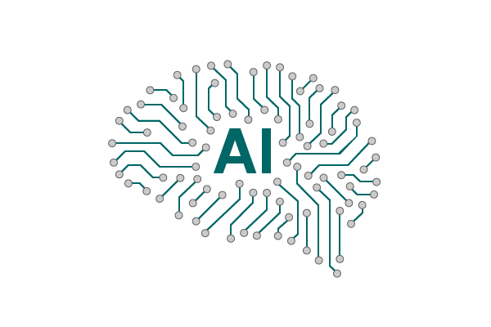
The Power of Generative AI
1
Efficiency 🚀
2
Creativity 🎨
Generative AI can automate complex tasks and reduce the workload of your employees, freeing up time to focus on important business tasks.
Generative AI can be used to design creative and unique solutions that stand out in the market, helping you differentiate from competitors.
3
Accuracy 🎯
Generative AI can analyze large amounts of data with great precision, allowing you to make more informed business decisions.

Slide 3

Market Landscape in India
Growing AI Adoption
The Indian market is experiencing a significant surge in the adoption of AI solutions across diverse industries. Businesses are embracing AI-driven technologies to improve operational efficiency, customer experience and decision-making processes.
Key Sectors Embracing AI
Various industries in India, including finance, healthcare, e-commerce and manufacturing are actively integrating AI into their operations. From personalized recommendations to predictive analytics. AI is reshaping the way these sectors operate and deliver value to their customers.
Government Support and Initiatives
The Indian government is actively supporting AI development and innovation through various initiatives. From funding AI research to promoting AI-based projects, the government's efforts are fueling the growth of AI technology and its widespread adoption across the nation.

Slide 4

Key Benefits of Generative AI
1
Enhanced Creativity
2
Cost Efficiency
Showcase how Generative AI enables clients to create unique and engaging content effortlessly.
Illustrate how AI-driven automation can lead to cost savings and increased productivity.
3
Personalization
Highlight the ability to cater to individual client preferences, leading to improved customer experiences.

Slide 5
Unique Features of EY's Generative AI Solutions
Flexible Deployment Options
Our solutions can be deployed on-premise or in the cloud, depending on your business needs.
1
2
3
Customizable Solutions
End-to-End Support
Our Generative AI solutions are tailored to the unique needs of your business.
We provide ongoing support and training to ensure the success of our solutions in your business operations.

Slide 6

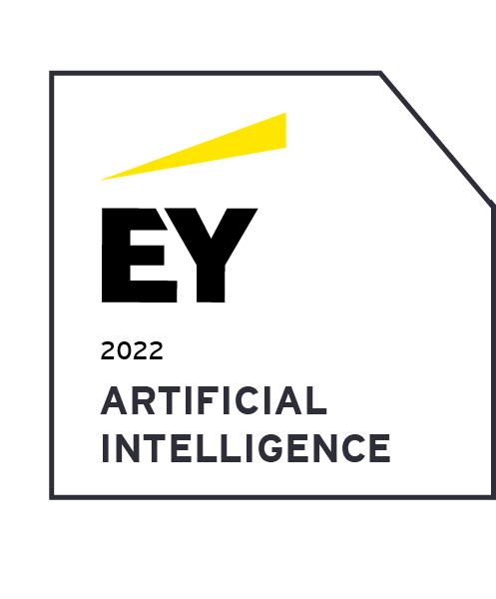
The EY Advantage
Big 4 Consulting Firm Advantage: As a part of the prestigious Big 4 consulting firms, EY brings a legacy of trust, credibility and a track record of delivering high-impact solutions to clients worldwide.
AI and Data Science Expertise: EY's seasoned AI and data science experts excel in Generative AI technologies, enabling cutting-edge value-driven solutions.
Industry-specific Knowledge: With experience across industries, EY tailors AI solutions to address your unique challenges and growth opportunities.
Global Footprint, Collaborative Approach: As a global firm, EY collaborates closely with your teams to co-create AI solutions aligned with your vision and strategy.
Ethical AI and Governance: EY prioritizes transparency, fairness and responsible AI practices, ensuring trust and upholding your organization's values.

Slide 7

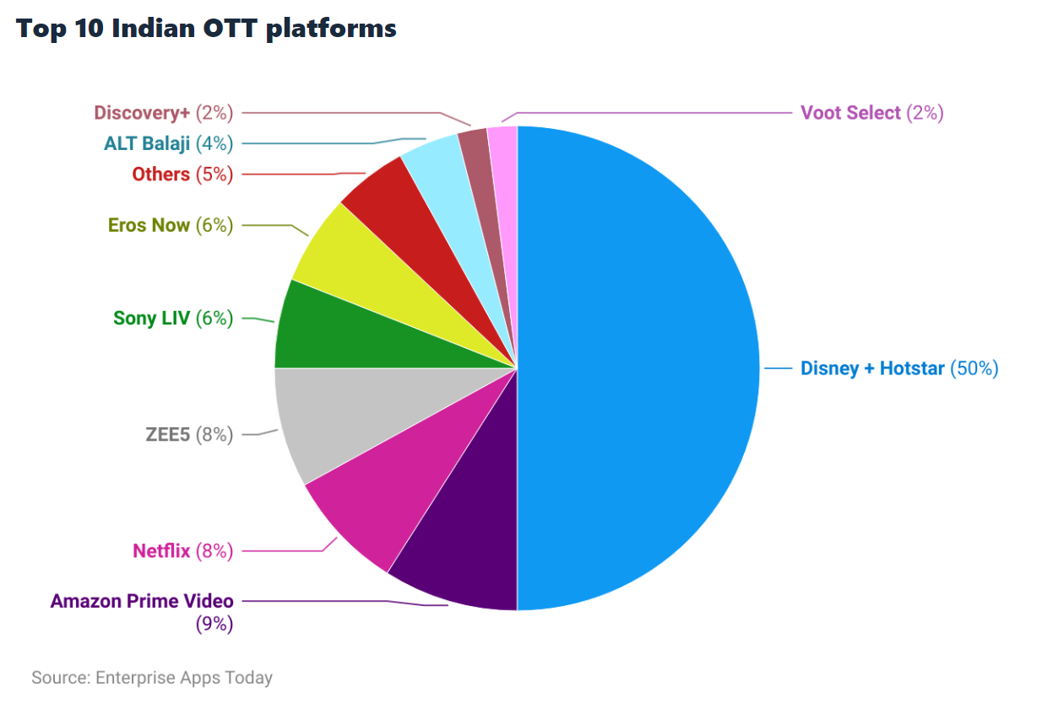
OTT Market Analysis : Disney + Hotstar
Disney+ Hotstar is an immersive and dynamic streaming platform that brings the enchanting worlds of Disney, Pixar, Marvel, Star Wars and more right to your fingertips. With an extensive library of beloved classics, thrilling originals and captivating shows. Disney+ Hotstar invites you to explore, connect and experience the magic of storytelling like never before.
1
Strengths
2
Weakness
Largest streaming platform in India with over 300 million subscribers
Wide variety of content, including movies, TV shows and live sports
Affordable subscription plans
Strong brand recognition
Competition from other streaming platforms such as Netflix and Amazon Prime Video
Some content is geo-restricted
3
Opportunities
Leverage its data to provide personalized recommendations and experiences
Expand into new markets
Produce more original content
Partner with other companies to offer bundled services

Slide 8


How AI is Changing the Game
for Media/Entertainment Industry
Disney + Hotstar is the largest streaming platform in India with over 300 million subscribers.
Disney + Hotstar generates over 16 million data points daily.
This data can be used to personalize content recommendations, generate new content ideas, automate tasks and improve the customer experience.
A recent study by Mckinsey found that AI could generate $1 trillion in value for the media and entertainment industry by 2030.
The study also found that AI could help the industry to:
Increase revenue by 20%.
Reduce costs by 15%.
Improve customer satisfaction by 25%.

Slide 9



Recommendations for Disney+ Hotstar
Using AI
Personalized Recommendations
Forecast for Future Trends
AI can provide viewers with personalized content and recommendations based on their preferences and viewing history.
AI-driven trend mapping tools can help anticipate and predict future consumer behavior, allowing for better-informed decisions.
AI-Driven Ads
Targeted Content
Interactive Content
Use AI to personalize ads and highlight relevant content, cross-promote videos and promote new titles that are more likely to resonate with your audience.
AI can analyze consumer preferences to determine which genres to focus on and tailor its content to strengthen engagement rates.
Make use of interactive content to engage your audience, bringing unique aspects to traditional content.

Slide 10
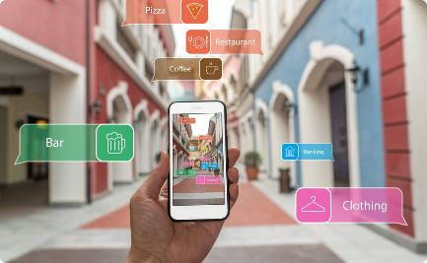

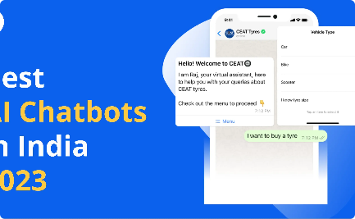
Case Studies of Successful Implementation of AI in India
Augmented Reality Application
Quality Control in Manufacturing
Chatbot for Customer Service
A major retail chain in India increased sales and customer engagement through our Generative AI-powered AR application.
A leading Indian automaker achieved significant improvements in production quality and efficiency through our Generative AI solutions.
A major Indian bank improved customer satisfaction and reduced costs through our Generative AI-powered chatbot.

Slide 11
Implementation Process
Consultation
Train & Validate
Deployment
During the initial phase, we immerse ourselves in understanding your unique business requirements, pain points and objectives. Our expert team collaborates closely with your stakeholders to gain deep insights into your workflows, challenges and strategic goals. Through this discovery phase, we identify opportunities where AI can make a significant impact on your business processes. By tailoring the AI solution to your specific needs, we ensure that it aligns perfectly with your existing systems and enhances your overall operations.
The heart of our implementation process revolves around training the AI models effectively. We gather relevant data sets and carefully pre-process them to ensure data quality and consistency. Our skilled data scientists then employ state-of-the-art techniques to train the AI models with precision. Rigorous validation processes are undertaken to ensure the accuracy and reliability of the AI solution. This crucial step guarantees that the AI models are capable of making sound decisions, delivering valuable insights and enabling data-driven decision-making in your organization.
With the AI solution optimized and tested, we seamlessly deploy it into your existing infrastructure. Our experienced team ensures a smooth integration process, minimizing disruptions to your business operations. Upon deployment, your team will receive comprehensive training and guidance on effectively utilizing the AI solution. We empower your team to harness the full potential of AI by providing them with the tools and knowledge needed to extract valuable insights, make informed decisions and drive innovation across your organization.

Slide 12

Return on Investment (ROI)
1
Cost Savings
2
Revenue Growth
Generative AI solutions can significantly reduce costs and improve efficiency in various business operations.
Our solutions have been shown to boost revenue growth through increased productivity, quality and customer engagement.
3
Competitive Advantage
Generative AI solutions can help your business stand out from competitors and gain a crucial edge in the Indian market.

Slide 13

Next Steps
1
The Future is Generative AI
Stay ahead of the curve and unlock the full potential of your business with EY's Generative AI solutions.
2
Get in Touch
Contact us today to schedule a consultation and learn more about how we can help your business thrive in the Indian market.

Slide 14

Thank You

